Slide 1
North South University
Department of Electrical & Computer Engineering
Junior Project Proposal

Slide 2
Project Title: Study Assistant
Group:
Shad Al Kaiser
ID: 172 1392 042
Ashraful Kalam Abid
ID: 172 1464 042
Faculty’s Name: Intisar Tahmid Naheen

Slide 3
Table of contents
Abstract------------------------------------4
Introduction & Background---------------5
Scopes--------------------------------------6
Methodology & Approach---------------7
Software & Budget-----------------------9
Time Plan-----------------------------------10
Expected Outcomes-----------------------12

Slide 4
Abstract
The Study Assistant project focuses on the growing use of online teaching materials for academic purposes. There are millions of assistive materials/video/tutorials on any given topic, this project focuses on bring the right result for the students. By scanning the books directly user can get thousands of relevant materials.
With the help of APIs the app detects and filters the texts to generate the subject of that scanned paragraph thus bringing the correct search result for the user. There can be two type of users, teacher and students who will be provided with their distinct features in the app.
Overall the project could be a solid medium for the academic pupils to get the desired help from millions of sources out in the web.

Slide 5
Introduction & Background
Learning things on internet is becoming an incremental part of student’s life at this time and age. Specially if we consider a time like this where the world is on a shut down. This project aims to help students with their online search for assistive study materials. It would help save a lot of precious time and ease the effort to find the right help for the topics the students are looking for. The app would also help the teachers to provide their students with additional materials regarding their courses.
Objectives
The objectives of this project are to,
Scan the text from pages directly.
Search for assistive materials for respective texts.
Let students & teacher exchange materials via app.

Slide 6
Scopes
Following tasks will be undertaken as a part of the proposed research,
Task 1 - Direct scan to find related materials.
Task 2 - Live communication feed between students and teachers.
Task 3 - Adding study materials.
Task 4 – Notifying individual users about their teachers activity.
Task 2 would not be included into this project for technical reasons, rest of the tasks are all part of this project.

Slide 7
Methodology & Approach
Since our project is an android application, we will be using Android Studio. For APIs and database we will use the Google Firebase platform to maximize the android environment. Some of the notable APIs that we will use are,
Firebase AUTH API, Firebase ML Vision API, Firebase storage, Firebase database, Play-service-AUTH API, Firebase Messaging API etc.
Constrains:
Project needs to be completed in next 3 months.
There are several learning contains.
Users needs to have compatible Android OS to run the program.
The system is depended on several APIs. Any unwanted set of difficulties in the remote APIs is a constraints for the system.
Challenges:
We need to have clear understanding of android development to do this project and it can be a lengthy process to learn the necessary stuffs to implements them into the project. We wont be able to Unit Test every components so it can leave some uncertainties in the final project.

Slide 8
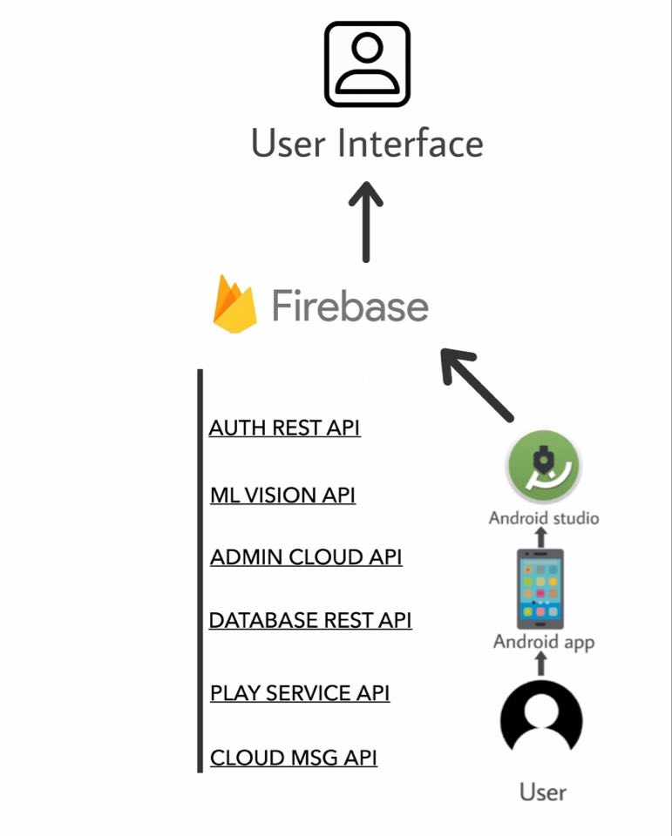
Design Approach:

Slide 9
Software used & Budget
We will use Android Studio and Firebase cloud service for the project. Since both of these are free software we don’t need any additional budget for the projects except the bare minimums.

Slide 10
Time Plan
Table 1 : Task List
Serial | Description
Task 1 | Establish Authentication
Task 2 | Connect Federated Authentication Service
Task 3 | Uploading Materials
Task 4 | Embedded Document Viewer
Task 5 | Text Recognition
Task 6 | Enabling Camera Access
Task 7 | Upload From Gallery
Task 8 | Connecting YouTube APIs
Task 9 | Filtering Texts
Task 10 | Searching for Assistive Materials

Slide 11
 | 12th July – 12th August |  |  |  | 13th August – 13th September |  |  |  | 14th September – 14th October
 | Week 1 | Week 2 | Week 3 | Week 4 | Week 1 | Week 2 | Week 3 | Week 4 | Week 1 | Week 2 | Week 3 | Week 4
Task 1
Task 2
Task 3
Task 4
Task 5
Task 6
Task 7
Task 8
Task 9
Task 10
Figure 1: Gantt Chart

Slide 12
Expected Outcomes
The project is entirely aimed to help the students. So the expectations are really just the satisfaction of the users and their convenience. The program is expected to speed up the process of finding the right materials.

Slide 13
Project Idea 2

Slide 14
Table of contents
Abstract------------------------------------15
Introduction & Background---------------16
Scopes--------------------------------------17
Methodology & Approach---------------18
Software & Budget-----------------------19
Time Plan-----------------------------------20
Expected Outcomes-----------------------22

Slide 15
Abstract
Online jobs are becoming more prominent day by day. This project is a Workplace website where different types of workers can enlist their services for the preferred price.
This is a web app will be called Worker Management and the idea is to make worker independent.
The web app will prove the platform for different types of freelancers find their jobs.

Slide 16
Introduction & Background
We will try to make a website which will help people to find worker nearby them. Like if a person need a plumber in Basundhara, this app will help him/her to find a plumber who lives in Basundhara. There will be many types of worker.
It will also help part time worker.
Objectives
The objectives of this project are to,
Creating Account.
Searching worker.
Contacting each other.

Slide 17
Scopes
Following tasks will be undertaken as a part of the proposed research,
Task 1 – Search Worker from nearby area
Task 2 – Adding job
Task 3 – Contacting Worker via mail.
Task 4 – Rating worker

Slide 18
Methodology & Approach
Since this is a web app , we will html,css to do design.And for database we will use local host. For that We will use XAMP. Sql,PHP will be requered
Constrains:
Project needs to be completed in next 3 months.
There are several learning contains.
Users needs computer to run the program.
Challenges:
We need to have clear understanding about Database.

Slide 19
Software used & Budget
We will use subline text , XAMP . Since both of these are free software we don’t need any additional budget for the projects except the bare minimums.

Slide 20
Time Plan
Table 1 : Task List
Task | Description
Task : 1 | Basic Html working
Task : 2 | Designing User Account
Task : 3 | Designing Worker Account
Task : 4 | Working on Database
Task : 5 | Working on communication way of users

Slide 21
 | 12th July – 12th August |  |  |  | 13th August – 13th September |  |  |  | 14th September – 14th October
 | Week 1 | Week 2 | Week 3 | Week 4 | Week 1 | Week 2 | Week 3 | Week 4 | Week 1 | Week 2 | Week 3 | Week 4
Task 1
Task 2
Task 3
Task 4
Task 5

Slide 22
Expected Outcomes
This project will give us a clear idea about database.
And a good way to learn about html,css,sql.

